Slide 1
CS118 – Programming Fundamentals
Lecture # 27
Tuesday, December 03, 2019
FALL 2019
FAST – NUCES, Faisalabad Campus
Course Instructor:
Ebad Majeed
Slides Credit:
Rizwan Ul Haq

Slide 2
What is a Pointer variable?
Pointer variables contain memory addresses as their values
Normally, a variable directly contains a specific value
A pointer variable contains the address of the location that contains the specific value
A variable is a direct reference to a value
A pointer is an indirect reference to a value
Referencing a value through a pointer is known as indirection

Slide 3
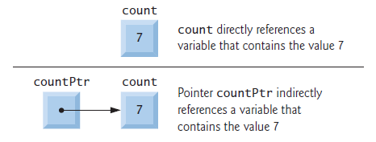
Pointer Elaborated
Fig. 8.1. | Directly and Indirectly referencing a variable

Slide 4
Declaring a pointer
Pointer must be declared before they can be used
Syntax to declare a pointer is
data_type *identifier;
E.g. int *iPtr;
double *dPtr;
iPtr and dPtr are pointers to integer and double respectively.
We read from right to left i.e. iPtr is a pointer to integer.
What if we declare
int *iPtr, count;
So two pointers must be declared as
int *iPtr, *countPtr;
Note: * applies only to iPtr. Count is not a pointer. It is a simple integer

Slide 5
Pointer initialization
Pointers must be initialized to 0, NULL or an address of corresponding type
Either in declaration or in assignment
A pointer with value 0 or NULL “points to nothing” and is known as null pointer
In the new standard, you should use the constant nullptr to initialize a pointer instead of 0 or NULL
int *iPtr = 0;
int *iPtr = NULL;
int iPtr = nullptr;

Slide 6

Pointer to a variable
int x = 5; // declare variable y
int *xPtr; // declare pointer variable xPtr
The statement
xPtr = &x; // assign address of x to xPtr
Assigns the value of variable y to xPtr
xPtr is said to point to x
Now xPtr is indirectly references x’s value
Fig. 8.2 | Graphical representation of a pointer pointing to a variable

Slide 7

Pointer in Memory
Figure 8.3 shows another pointer representation in memory with integer variable y stored at memory location 600000 and pointer variable yPtr stored at memory location 500000. The operand of the address operator must be an lvalue; the address operator cannot be applied to constants or to expressions that do not result in references.
Fig. 8.3 | Representation of y and yPtr in memory.

Slide 8
Dereferencing a Pointer
* operator, commonly referred to as the indirection operator or dereferencing operator, returns a synonym (i.e., an alias or a nickname) for the object to which its pointer operand points. For example (referring again to Fig. 8.2), the statement
cout << *yPtr << endl;
prints the value of variable y, namely, 5, just as the statement
cout << y << endl;
would. Using * in this manner is called dereferencing a pointer

Slide 9
Dereferencing a Pointer
A dereferenced pointer may also be used on the left side of an assignment statement, as in
*yPtr = 9;
which would assign 9 to y in Fig. 8.3. The dereferenced pointer may also be used to receive an input value as in
cin >> *yPtr;
which places the input value in y. The dereferenced pointer is an lvalue
Note: The & and * operators are inverses of one another

Slide 10
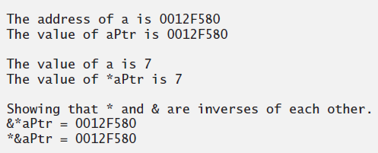
Sample Program – I
1 // Fig. 8.4: fig08_04.cpp
2 // Pointer operators & and *.
3 #include <iostream>
4 using namespace std;
5
6 int main()
7 {
8 int a; // a is an integer
9 int *aPtr; // aPtr is an int * which is a pointer to an integer
10
11 a = 7; // assigned 7 to a
12 aPtr = &a; // assign the address of a to aPtr
13
14 cout << "The address of a is " << &a
15 << "\nThe value of aPtr is " << aPtr ;
16 cout << "\n\nThe value of a is " << a
17 << "\nThe value of *aPtr is " << *aPtr;
18 cout << "\n\nShowing that * and & are inverses of "
19 << "each other.\n&*aPtr = " << &*aPtr
20 << "\n*&aPtr = " << *&aPtr << endl;
21 } // end main

Slide 11
Pass by reference with pointers
There are three ways to pass an argument to a function
Pass-by-Value
Pass-by-reference with reference argument
Pass-by-reference with pointer argument
Pointers, like references,
can be used to modify one or more variables in the caller
to pass pointers to large data objects to avoid the overhead of passing the objects by value

Slide 12
Pass-by-Reference with pointers
1 // Fig. 8.7: fig08_07.cpp
2 // Pass-by-Reference used to cube a variable’s value.
3 #include <iostream>
4 using namespace std;
5
6 int cubeByValue( int *); // prototype
7
8 int main()
9 {
10 int number = 5;
11
12 cout << "The original value of number is " << number;
13
14 cubeByReference( &number ); // pass number address to cubeByReference
15 cout << "\nThe new value of number is " << number << endl;
16 } // end main
17
18 // calculate the cube of *nPtr; modifies the variable in main
19 int cubeByReference( int* nPtr )
20 {
21 *nPtr = *nPtr * *nPtr * *nPtr; // cube *nPtr
22 }

Slide 13
Step 1: Before main calls cubeByReference:
int main() { cubeByReference(&number); } | void cubeByReference( int *nPtr ) { *nPtr = *nPtr * *nPtr * *nPtr; }
Step 2: After cubeByReference receives the call and before *nPtr is cubed:
int main() { cubeByReference(&number); } | void cubeByReference( int *nPtr ) { *nPtr = *nPtr * *nPtr * *nPtr; }
Step 3: After *nPtr is cubed and before program control returns to main
int main() { cubeByReference(&number); } | void cubeByReference( int *nPtr ) { *nPtr = *nPtr * *nPtr * *nPtr; }
number
5
int number = 5 ;
nPtr
undefined
number
5
int number = 5 ;
nPtr
Call established this pointer
number
125
125
int number = 5 ;
Called function modifies caller’s
variable
nPtr

Slide 14
Questions

